Slide 1
Company Overview

Slide 2
Overview
Pole Star Space Applications Limited is a privately owned company headquartered in London, providing services to the global maritime industry.
With five international office locations, and a network of over 60 distributors, we aim to be the principal provider of fleet management, ship security, LRIT and fisheries monitoring services.
To be the world’s leading provider of
Fleet Management,
Ship Security and Vessel Monitoring systems to the Maritime Industry
2

Slide 3
TIMELINE: History of Pole Star
Pole Star Founded
As UK based provider of satellite based tracking services
Pole Star &
Absolute Merge
Combining product lines
and office locations
International Track 100
Ranked in Sunday Times Top 100 fastest growing companies
Boston
Office opened
Sydney
Office opened
Absolute Software
Founded
Hong Kong
Office opened
Panama
Office opened
1998
1999
2000
2001
2002
2003
2004
2005
2006
2007
2008
2009
2010
2011
2012
2013
SmartTRAC
Fisheries Vessel Monitoring System
introduced
DSAS &
Alert Advanced
Ship Security Alert System (SSAS)
hardware and services are introduced to meet new IMO requirement
Marine Asset Tracker
Hardware options and tracking solution introduced for the
offshore oil & gas,
tug, barge and workboat market
LRIT
Data Centre
IMO introduces a new global ship tracking system. Pole Star now holds contracts to supply service to 4 of the top 5 flag registries
Purplefinder
Web based fleet monitoring system
introduced
Purplefinder Pro
Our next generation fleet monitoring platform is being progressively introduced across all product lines
3
3

Slide 4
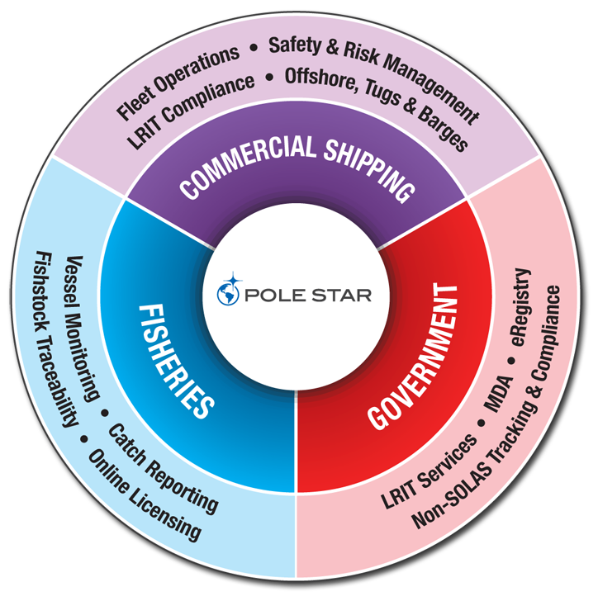
Products
To be the world’s leading provider of
Fleet Management,
Ship Security and Vessel Monitoring systems to the Maritime Industry
4

Slide 5
Highlights
Pole Star monitors approximately 40,000 ships
for over 1,250 clients located in over 90 countries.
We serve the biggest names in the industry
in oil & gas, container lines, logistics & freight, cruise lines and more.
World’s largest LRIT data centre provider with 45 flags
including 4 of the top 5 flags: Panama, Liberia, the Marshall Islands and Singapore.
Over 25,000 ships carry Pole Star LRIT certificates issued on behalf of over 90 flags.
Our fisheries monitoring services cover over 50M square miles of seas
We monitor the location of over 6,000 fishing vessels on a daily basis, collecting additional
catch data from 2,000 vessels via electronic logbooks.
All our products are supported by a multi-national team
located in London, Boston, Panama, Hong Kong and Australia
and fluent in over 20 languages.
To be the world’s leading provider of
Fleet Management,
Ship Security and Vessel Monitoring systems to the Maritime Industry
5

Slide 6



Brands
Under the Purplefinder™ brand, Pole Star develops innovative and reliable systems that enable our commercial shipping customers to monitor and manage their assets worldwide.
These systems are currently used to track over 15,000 merchant ships worldwide.
Pole Star operates LRIT Data Centres for more than 40 flags with 16,000 ships including Panama, Singapore, the Marshall Islands, Liberia, Australia and Canada.
We also provide LRIT Conformance Testing and Certification for more than 90 flags.
Through the Absolute Software™ brand, Pole Star offers complete Vessel Monitoring Solutions (VMS) to fisheries authorities.
Customers in over 20 countries monitor over 6,000 commercial fishing vessels and receive electronic catch data from an additional 2,000 vessels.
6

Slide 7


Commercial Shipping
Fleet Management
Marine Asset Tracker 2.0
Safety & Risk Management
Ship Security Alert Systems (SSAS)
Ship Security Reporting System (SSRS)
LRIT Conformance Testing
Commercial Customers
7
7

Slide 8
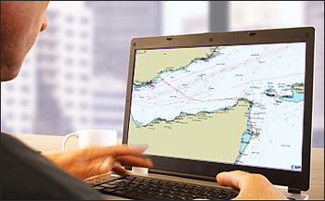
Fleet Management
Over 6,500 ships are tracked with Fleet Management. Improved voyage management, cost savings and ETA adjustments are just a few of the commercial advantages enjoyed by users of our web-based software.
Monitor vessel performance with automatic tracking
Track history for precise off-hire calculations
Global weather forecasting and meteorological information
Enhanced risk management using geo-zone notifications
View fleet on marine charts and 3D mapping applications
e.g. Google Earth
Polling – position report on demand
Manage access to data with secure logins
that limit access to authorised parties
Position reports sent to email and SMS – for
out of office updates
AMVER reporting option
8

Slide 9
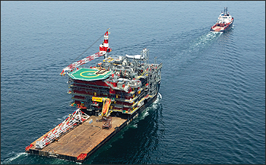
Marine Asset Tracker
Marine Asset Tracker (MAT) 2.0 comprises reliable satellite tracking hardware linked to a powerful web-based service that provides an effective way of automatically tracking marine assets in realtime.
Developed specifically for tug and barge operators,
offshore support and oil exploration companies and
coastal fleet operators
Over 1,500 tugs, barges and rigs are monitored by Pole
Star with the Marine Asset Tracker product range
Custom satellite/hardware/service plan options to meet
the unique needs of each asset in the fleet
Weather overlays and key industry zones
HDtrack - Intelligent realtime reporting
(exclusive to MAT-IDP690)
Restrict access and monitor usage with
advanced user management tools & logs
9

Slide 10
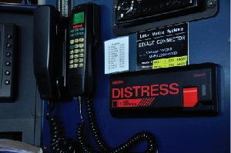
Ship Security Alert Systems (SSAS)
Pole Star provides the most effective and reliable Ship Security Alert System hardware available. With over 6,500 units installed worldwide, Pole Star's SOLAS XI/2-6 compliant DSAS unit has been proven in service on numerous occasions.
Manage fleet security using a proven and reliable
Ship Security Alert System
Secure logins to limit access to only authorised parties
Control distribution of data to designated recipients
Access the system via mobile phone for alerts, polling
and vessel positions
Use email/SMS/fax for out-of-office
notifications
Integrate other major manufacturers’ SSAS
hardware in order to manage fleet security
on one system
10

Slide 11
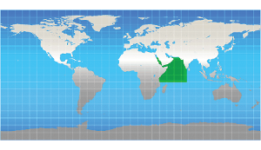
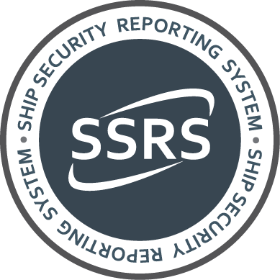
Ship Security Reporting System (SSRS)
In 2009 Pole Star was requested by a number of flags and ship operators to develop a counter-piracy product that could assist deployed naval forces by providing realtime information on pirate attacks.
In response, Pole Star launched the Ship Security Reporting System (SSRS). An innovative counter-piracy service that enhances the effectiveness of existing Ship Security Alert Systems by providing a link from a ship sending an alert direct to MSCHOA, UKMTO, and NATO and associated participating naval forces responsible for maritime security in the Gulf of Aden and off the Somali coast.
11

Slide 12
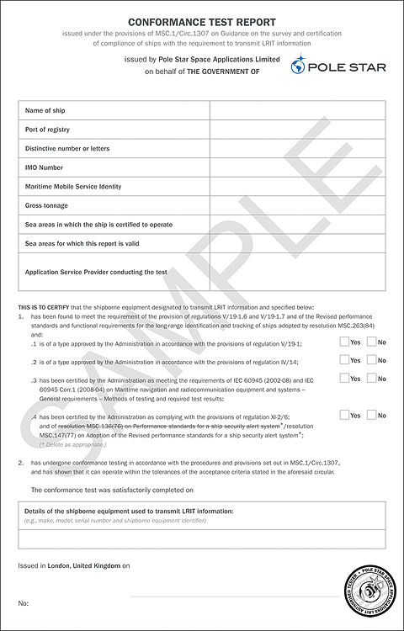
LRIT Conformance Testing
Pole Star is an Authorised Testing ASP for over 90 flags and provides a secure web-based system where the ship operator is able initiate a test and review its progress at any time.
To date, Pole Star has completed more than 40,000 LRIT tests on behalf of global ship operators.
…………………………………………………………………………….
LRIT Conformance Test Reports (Certificates) are the only proof of LRIT compliance. The document, which is issued on completion of a successful test, is a mandatory requirement for radio surveys and inspection and must be kept onboard the vessel.
To date, Pole Star has issued nearly 25,000 Certificates on behalf of over 90 flags.
12

Slide 13

Commercial Customers
Pole Star serves over 1,250 commercial customers representing a wide range
of companies from sectors such as:
Oil & gas
Logistics & freight
Container lines
Cruise lines
13

Slide 14

Government
Long-Range Identification & Tracking
Data Centre/ASP Services
Case Study: Panama Maritime Authority
Government Customers
Maritime Domain Awareness
14
14

Slide 15
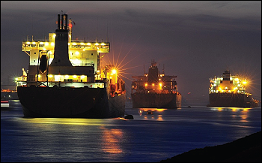
Long-Range Identification & Tracking
Pole Star offers a comprehensive end-to-end LRIT service that consists of the most cost-effective and expandable data centre solution available. The company operates data centres on behalf of over 40 flag administrations, monitoring more than 16,000 ships, including those of Panama, Singapore, Liberia, and the Marshall Islands – the largest fleets in the International Maritime Organization’s LRIT network.
The LRIT regulations apply to the following ship types engaged on international voyages:
All passenger ships, including high speed craft
Cargo ships, including high speed craft of 300 gross
tonnes and above
Mobile offshore drilling units
15

Slide 16
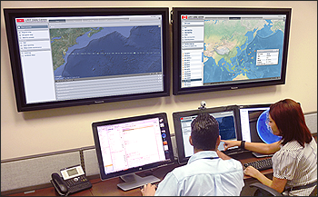
Data Centre/ASP Services
Pole Star has provided ship tracking services to governments and the industry for more than 10 years. The company was the first to establish a demonstration National Data Centre during the LRIT prototype stage.
Flags appointing Pole Star as their data centre provider will be supported by a professional and committed ASP dedicated to the provision of the most sophisticated and technically advanced schedule of LRIT services.
Data centre provider and manager for 45 flags
Authorised Service Provider for over 90 flags
More than 16,000 ships monitored
Sophisticated web-user interface with advanced LRIT
and fleet management functions
24/7 multilingual support
16

Slide 17
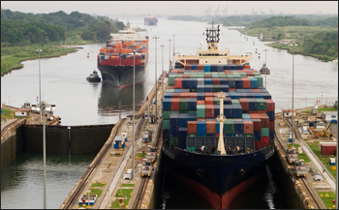
Case Study: Panama Maritime Authority LRIT
Pole Star operates the data centre for Panama, the largest National Data Centre within the International Maritime Organization’s Long-Range Identification and Tracking system.
The world’s largest merchant marine fleet is managed by the Panama Maritime Authority (AMP). This includes over 8,000 ships in excess of 200 million Gross Registered Tons (GRT).
10,000,000+ LRIT positions received
7,200+ successful Panamanian conformance tests
6,000+ positions/day forwarded to other data centres
via the International Data Exchange (IDE)
Manned by duty officers 24/7/365
Realtime counter-piracy coordination
(with NATO and EU taskforces)
17

Slide 18
Government Customers
LRIT Data Centre
LRIT Conformance Testing
Fisheries Management*
Services provided:
Algeria
Antigua & Barbuda
Argentina
Australia
Bahamas
Bahrain
Bangladesh
Barbados
Belgium
Belize
Bermuda
Bolivia
Brazil
British Virgin Islands
Brunei Darussalam
Canada
Cape Verde
Cayman Islands
Chile
China
Cook Islands
Croatia
Curacao
Cyprus
Denmark
Dominica
Ethiopia
Egypt
Estonia
Faroe Islands
Falkland Islands
Federated States of Micronesia
Fiji
Finland
France
The Gambia
Germany
Ghana
Gibraltar
Greece
Guyana
Honduras
Hong Kong
India
Indonesia
Ireland
Isle of Man
Israel
Italy
Jamaica
Japan
Jordan
Kenya
Kiribati
Korea
Kuwait
Latvia
Liberia
Lithuania
Luxembourg
Madeira
Malaysia
Maldives
Malta
Marshall Islands
Mexico
Montenegro
Mozambique
Myanmar
Namibia
Nauru
The Netherlands
New Zealand
Nigeria
Niue
Norway
Oman
Pakistan
Palau
Panama
Papua New Guinea
The Philippines
Poland
Portugal
Qatar
Romania
Russia
St. Kitts and Nevis
St. Vincent and the Grenadines
Samoa
Saudi Arabia
The Seychelles
Sierra Leone
Singapore
Slovak Republic
Slovenia
Solomon Islands
South Africa
Spain
Sudan
Sweden
Switzerland
Taiwan
Thailand
Tokelau
Tonga
Trinidad and Tobago
Turkey
Tuvalu
Ukraine
United Arab Emirates
United Kingdom
United States
Uruguay
Vanuatu
* Includes high-seas monitoring under regional fisheries management treaties.
18

Slide 19
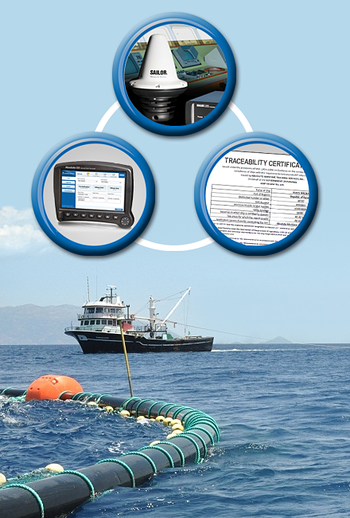
Fisheries Solutions
Overview
From Ocean to Dinner Plate
Fisheries Monitoring Center
Electronic Logbooks
19
19

Slide 20
The Complete Range of Fisheries Solutions
Fisheries authorities, in 35 countries and territories, rely on Pole Star fisheries
solutions for environmental monitoring of more than 6,000 fishing vessels.
Our depth of experience in this field is unmatched and demonstrated by the
provision of the most complete series of vessel and catch monitoring
products available.
Pole Star offers a full range of fisheries solutions, including:
Vessel Monitoring Systems (VMS)
Electronic logbooks
Electronic catch reporting
To be the world’s leading provider of
Fleet Management,
Ship Security and Vessel Monitoring systems to the Maritime Industry
Quota management systems
Seafood traceability reporting
Catch documentation systems
20

Slide 21
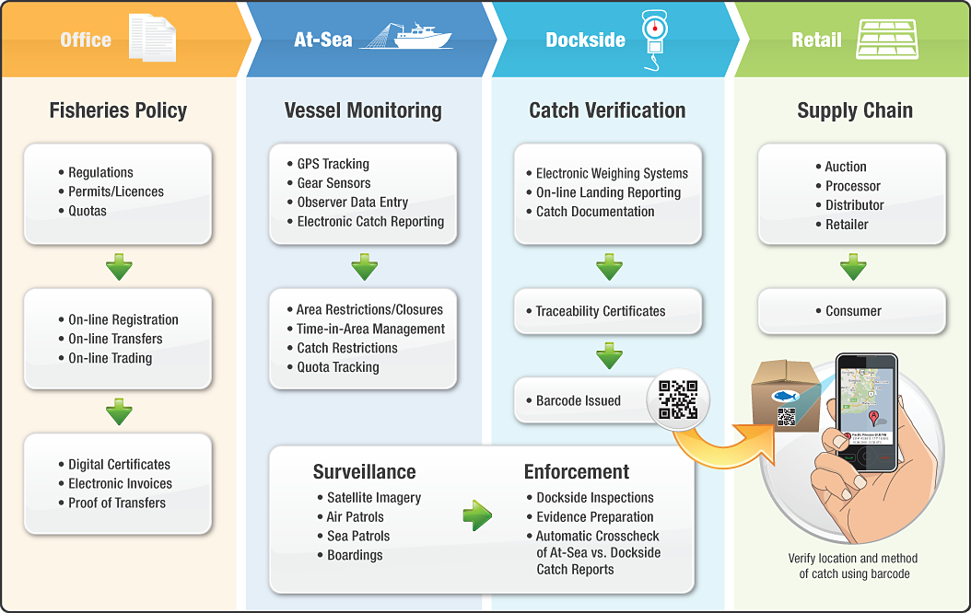
Pole Star Fisheries Solutions – from Ocean to Dinner Plate
21
21

Slide 22
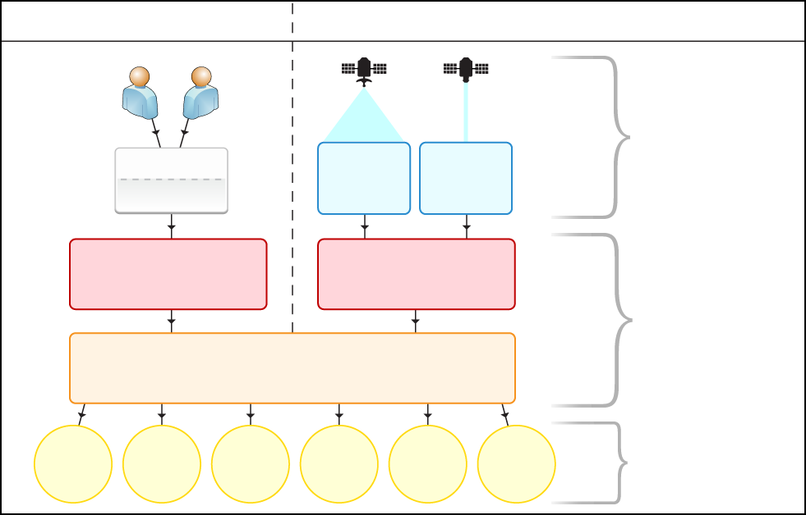
Overview of the Fisheries Monitoring Center
Vessels with VMS
IUU Vessels (no VMS fitted)
Captain
Observer
Ship
E-Forms
GPS Tracking
Ocean &
Meteorological
Data
Synthetic
Aperture
Radar
Communication
Service Providers
Data
Providers
Fisheries
Monitoring Centre
Pole Star Fisheries Solutions
Licensing
Permits
Search & Rescue
Fisheries Science
Quota
Mgmt
Enforcement
Legal
Users

Slide 23
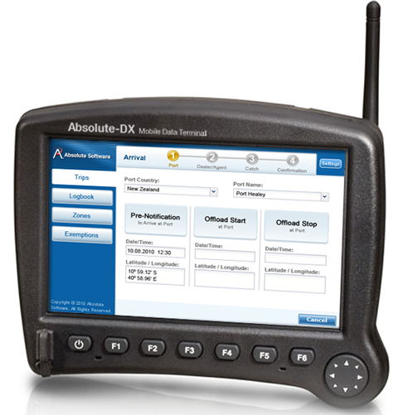
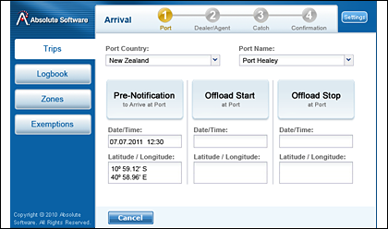
Customisable Electronic Forms
Pole Star has a library of over 50 fisheries e-forms which can be used to monitor and manage catch levels remotely and in realtime. These include notice of port call, arrival documentation and more.
Electronic form types include:
Trawl-by-trawl catch reporting
Daily catch logs
Transshipment, disposal and landing
Declaration of activity (Days-at-Sea)
Requests for exemptions or waivers
Pre-landing notifications
23

Slide 24
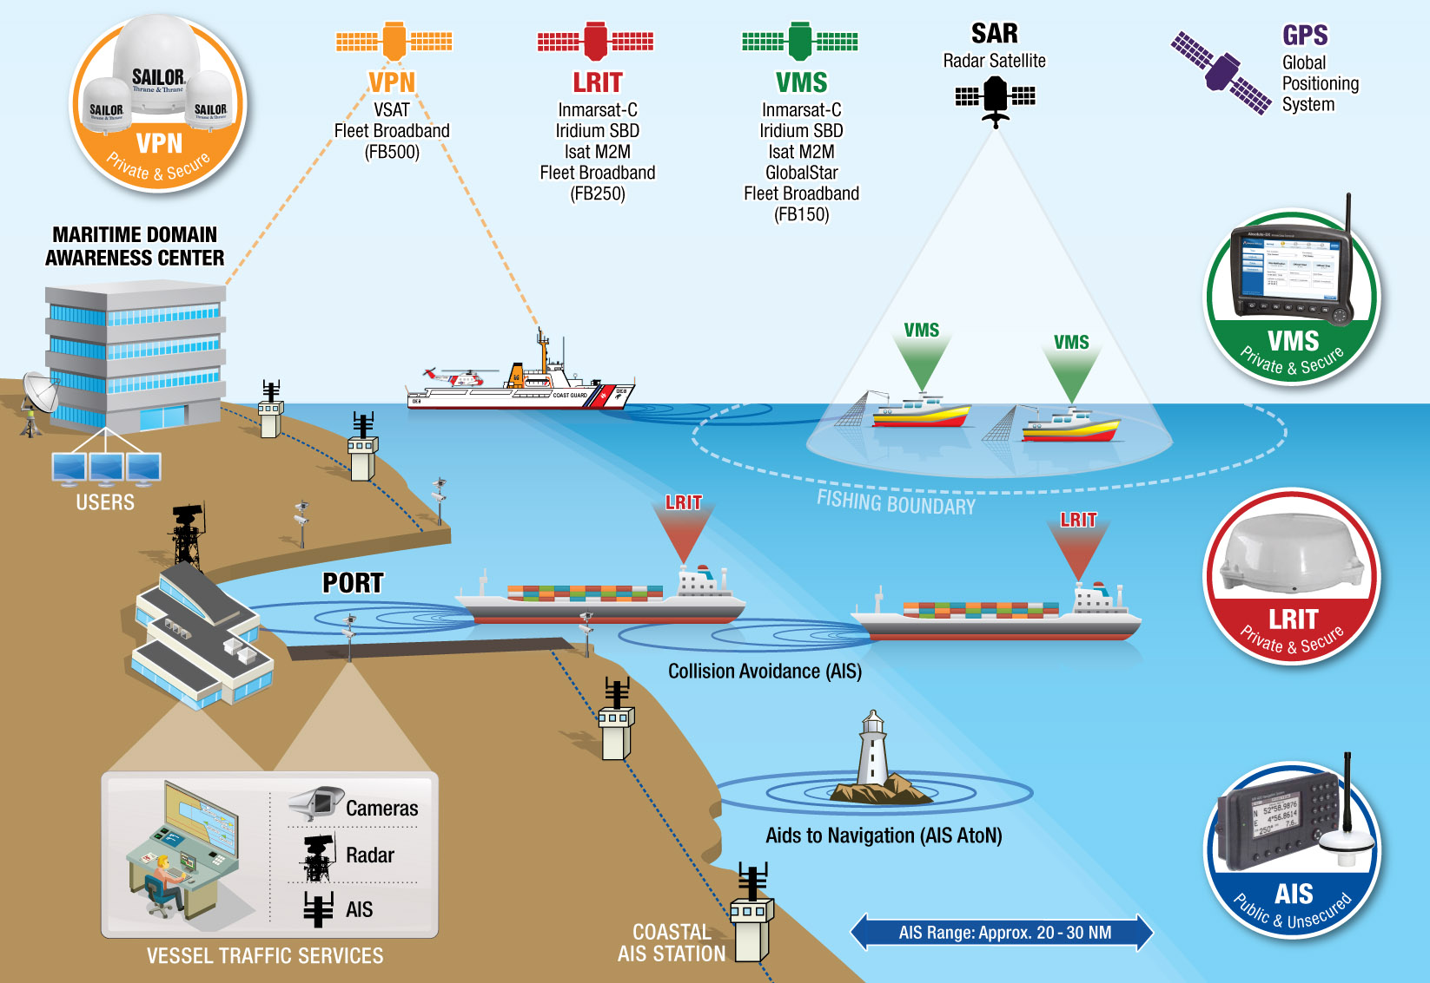
Maritime Domain Awareness – Integrating VMS, LRIT and AIS

Slide 25

Support
Global Distributor Network
Customer Support & Training
Technical Support
25
25
25

Slide 26
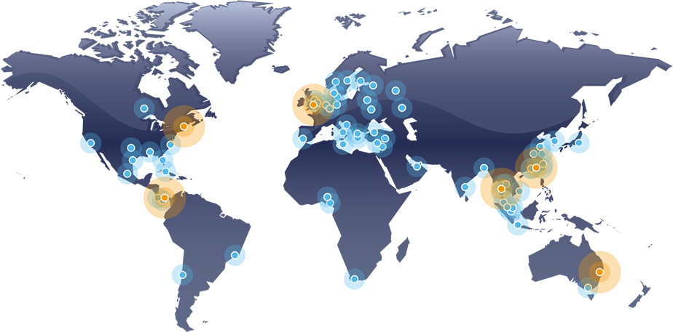
Global Distributor Network
Pole Star’s network of 60+ distributors and Approved Service Centres located around the world are an integral part of the Pole Star machinery, providing spare parts and service at a moment’s notice, allowing vessels to trade seamlessly wherever they are in the world.
• Pole Star office
• Distributor location
26

Slide 27

Customer Support & Training
Because we have teams in London, Hong Kong and Panama, we can offer our customers 24/7 multilingual support. Our global team of product experts provide service support, technical support, training, troubleshooting and diagnostics around the clock, by phone and email.
Dedicated support teams provide one-to-one product training to all new customers, either in person or remotely via screen sharing software. Our training programme means customers can experience the full benefits of our products immediately. All our products and services are provided with complete documentation.
27

Slide 28

Technical Support
Pole Star’s technical support team operates from three continents on a 24/7 basis, providing network and system monitoring, technical support and systems integration. As experts in their field and possessing many years of experience in satellite communications technologies, Pole Star’s technical support team are
uniquely qualified to offer specialised support for the company’s systems and customers.
The team monitors the satellite networks and Pole Star’s systems via a bespoke live monitoring tool that allows technicians to identify and resolve potential issues quickly, thus minimising impact on services to the customer.
28

Slide 29
Thank You
For further information please contact us at: sales@polestarglobal.com
Head Office:
Compass House, 4th Floor
22 Redan Place
London W2 4SA
United Kingdom
Tel: +44 20 7313 7400
United States of America:
101 Federal Street,
19th Floor
Boston, MA 02110
Tel: +1 617 800 9367
Australia:
Level 2, ITAMS Building
Innovation Campus
University of Wollongong
Wollongong, NSW 2522
Tel: +61 2 4221 5284
Hong Kong:
1708 Harcourt House
39 Gloucester Road
Wan Chai, Hong Kong
Tel: +852 2520 0951
Panama:
City of Knowledge, No 221
Panama, Republic of Panama
Tel: +507 301 5748
Visit us online at: www.polestarglobal.com

